Slide 1
American Government & The Bill of Rights
Name(s)

Slide 2
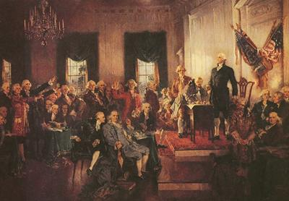
Before the Constitution
The major problem with the ________________________ was that the states had too much power and could not agree.

Slide 3
Requirements to be President
http://usgovinfo.about.com/od/thepresidentandcabinet/a/presrequire.htm
Using the link above, tell me what the 3 requirements are to be President.
1.
2.
3.

Slide 4
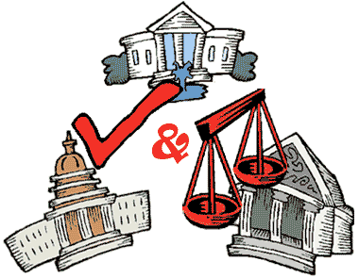
Powers that make sure one branch does not become too powerful.
What is the above picture and definition referring to?

Slide 5
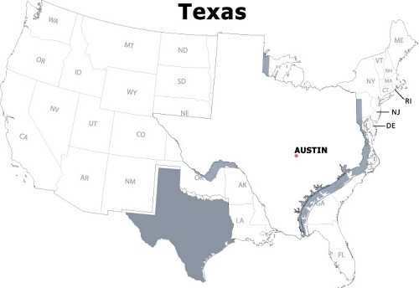
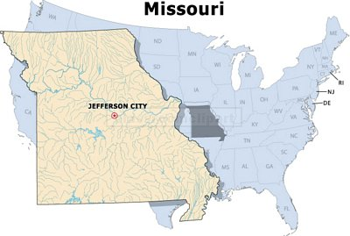
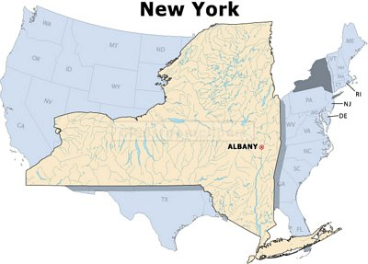
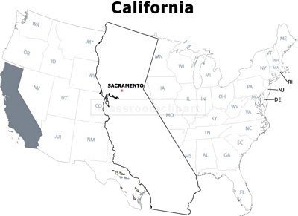
How many Electoral College Votes will each of these states have in the 2012 Presidential Election?

Slide 6
Citizens
What is the difference between a naturalized citizen and a natural-born citizen?

Slide 7
Terms
How long is the Term for each of the following?
Representative in Congress-
President of the United States –
Senator in Congress –
Justice on the Supreme Court –
Options
2 Years
4 Years
6 Years
Lifetime

Slide 8
Congress
Search for, and copy and paste the official Seals of the two parts that make up the United States Congress?
Example of a seal

Slide 9
Amendment
What is the definition of the word Amendment? Highlight the correct answer.
To change or add something.
To sew something together.
“yes” or “no” vote on a bill.
To refuse to sign a bill into law.

Slide 10
Location, Location, Location
Both houses of Congress meet and vote on laws at this building: ___________.
The Supreme Court meets at the _____________.

Slide 11
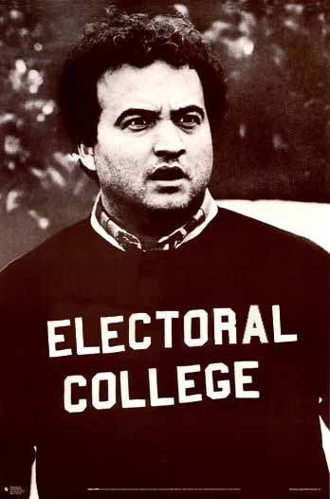
Electing the President
The President of the United States is technically elected by the ________.

Slide 12
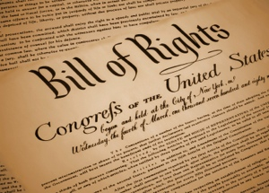
Bill of Rights
The first ___ Amendments to the Constitution is called the Bill of Rights.

Slide 13
Tell me which of the Bill of Rights is being described below. You will need to know all 10 Amendments for tomorrow’s test.
Write your answer in a different color
If you cannot afford a lawyer, he is promised “assistance of counsel,” which means a lawyer will help him for free.
If arrested, you have the right to remain silent and not say anything.
Police cannot search your house without a warrant or probable cause.
You cannot be beaten with whips by 2nd graders for committing a crime.
President Obama cannot force you to give food and shelter to soldiers.
You are guaranteed the right to own a rifle to hunt with and protect yourself with.
You have the freedom to tell your friends about your religious belief.
You have the right to create a newsletter expressing his anger against taxes.
You have the right to start a petition to support a law against texting while driving.

Slide 14
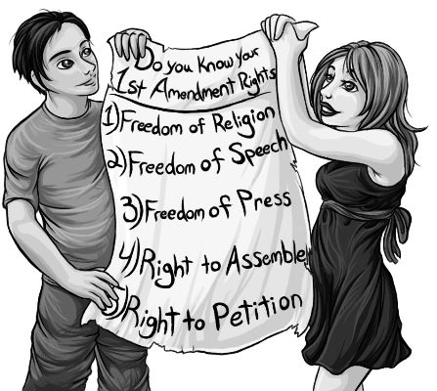
The Five Freedoms of the 1st Amendment
Find a picture to represent each of the five freedoms listed above.
You will need a total of FIVE pictures

